Slide 1


AI Stock Trading System
AAI 590 – Capstone
Group 6
Javon Kitson, Nathan Metheny, Adam Graves

Slide 2
Key Discussions
The System
Goals
Performance
AI Services
Results
Trading Results
Dataset
Usage
DRL Models
Scores
Compliance
Stakeholders
Model Flow

Slide 3
Project Goals
Smart Stock Trading system for personal investments
AI Model driven trading decisions: Machine Reinforcement Learning
Adhere to Compliance Regulations

Slide 4
Stakeholders
Personal investment individuals that signed up for the service
Company Investors

Slide 5
Usage
Software as a Service (SaaS): Web Based
Monthly Subscription fee
AI based stock trading decisions aligned with personal portfolio requirements
Performance Reporting Services

Slide 6
The Dataset
Purchased from First Rate Data: https://firstratedata.com/cb/4/complete-stocks-etf
Volume: 262GB
Unique Tickers: 10120 ~7k Stocks + ~3k ETFs
Portfolio Data from client-subscription input

Slide 7
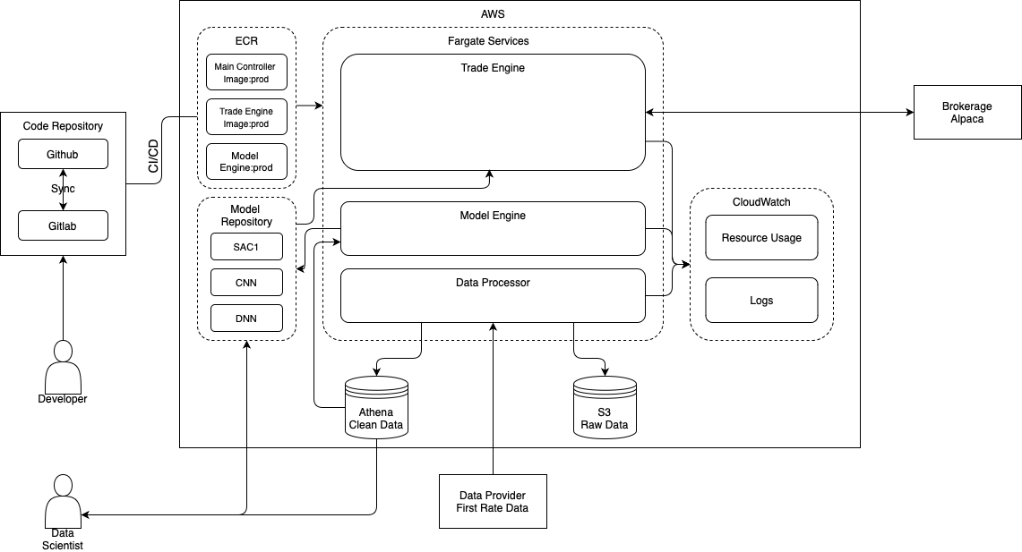
System Performance

Slide 8
System Performance
Dataset ETL services:
Data Cleaning
Data Transformation
Feature Engineering
Exploratory Data Analysis (EDA)
Analyze data fields
Check for data field correlations
Print results and visualization plots

Slide 9
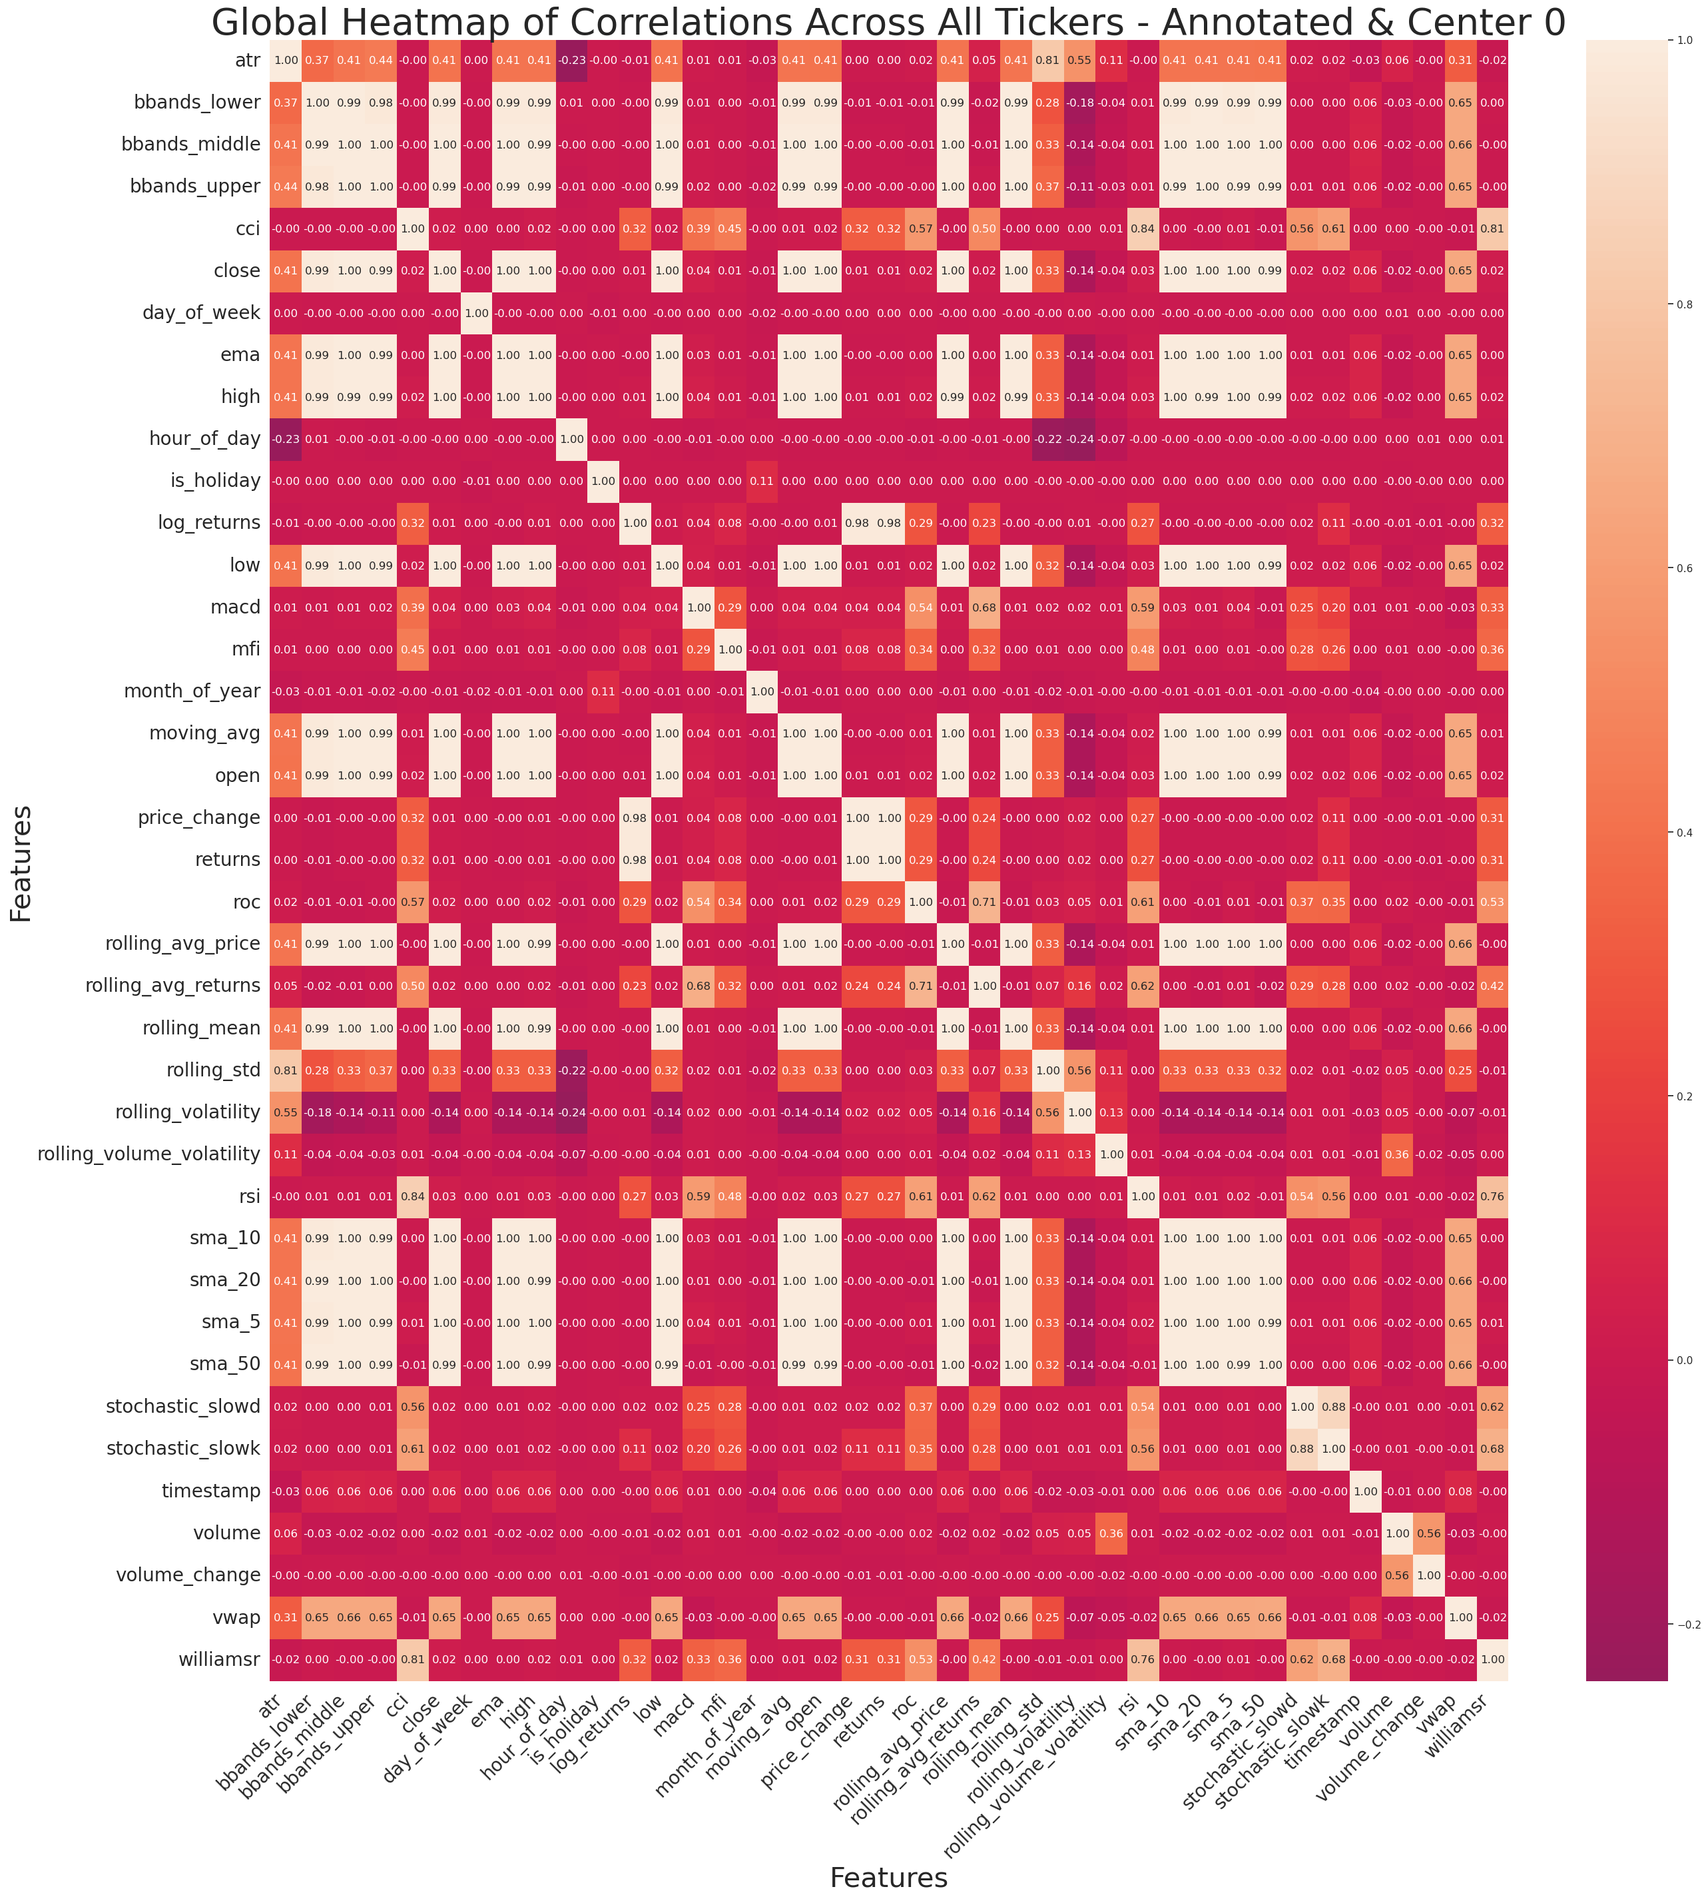
Field Correlations

Slide 10
System Performance
Data Repository
Athena Database and related tables
Perform Feature Engineering
Build Deep Learning Model (SAC1, CNN, DNN)
Build Portfolio Optimization Algorithm
Build a Forward Neural Network: Integration of Portfolio data
Build API to Trading System (ALPACA)

Slide 11
Model Scores

